Slide 1


CSE3078 – Cryptography and Network Security
School of Computer Science and Engineering

Slide 2
Module 4
Network Security

Slide 3
User Authentication
will consider authentication functions
developed to support application-level authentication & digital signatures
will consider Kerberos – a private-key authentication service
then X.509 directory authentication service

Slide 4
Kerberos
Kerberos is an authentication service developed as part of Project Athena at MIT.
The problem that Kerberos addresses is this: Assume an open distributed environment in which users at workstations wish to access services on servers distributed throughout the network.
We would like for servers to be able to restrict access to authorized users and to be able to authenticate requests for service.
In this environment, a workstation cannot be trusted to identify its users correctly to network services

Slide 5
In particular, the following three threats exist:
1. A user may gain access to a particular workstation and pretend to be another user operating from that workstation.
2. A user may alter the network address of a workstation so that the requests sent from the altered workstation appear to come from the impersonated workstation.
3. A user may eavesdrop on exchanges and use a replay attack to gain entrance to a server or to disrupt operations.

Slide 6
In any of these cases, an unauthorized user may be able to gain access to services and data that he or she is not authorized to access.
Rather than building in elaborate authentication protocols at each server, Kerberos provides a centralized authentication server whose function is to authenticate users to servers and servers to users.
Kerberos relies exclusively on symmetric encryption, making no use of public-key encryption

Slide 7
Kerberos listed the following requirements.
Secure: A network eavesdropper should not be able to obtain the necessary information to impersonate a user.
Reliable: Kerberos should be highly reliable and should employ a distributed server architecture with one system able to back up another
Transparent: Ideally, the user should not be aware that authentication is taking place beyond the requirement to enter a password.
Scalable: The system should be capable of supporting large numbers of clients and servers.

Slide 8
Kerberos 4 Overview
a basic third-party authentication scheme
have an Authentication Server (AS)
users initially negotiate with AS to identify self
AS provides a non-corruptible authentication credential (ticket granting ticket TGT)
have a Ticket Granting server (TGS)
users subsequently request access to other services from TGS on basis of users TGT

Slide 9
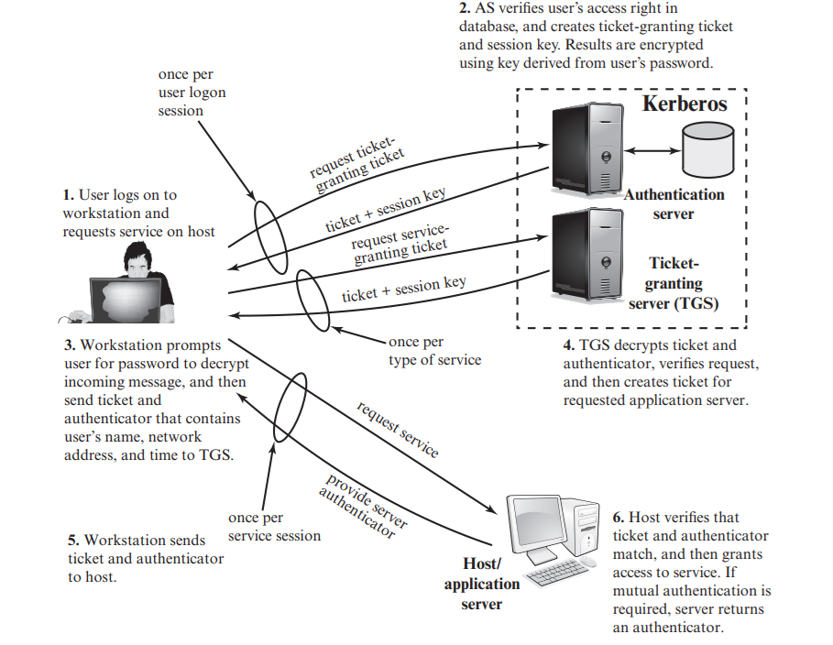
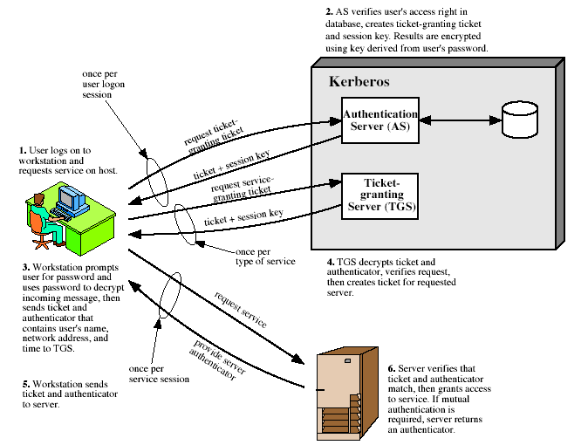
Kerberos 4 Overview

Slide 10
Kerberos Version 5
developed in mid 1990’s
provides improvements over v4
addresses environmental shortcomings
encryption alg, network protocol, byte order, ticket lifetime, authentication forwarding, interrealm auth
and technical deficiencies
double encryption, non-std mode of use, session keys, password attacks
specified as Internet standard RFC 1510

Slide 11
Public Key Infrastructure
Public Key Infrastructure (PKI) A set of policies, processes, server platforms, software and workstations used for the purpose of administering certificates and public-private key pairs, including the ability to issue, maintain, and revoke public key certificates.
The principal objective for developing a PKI is to enable secure, convenient, and efficient acquisition of public keys.

Slide 12
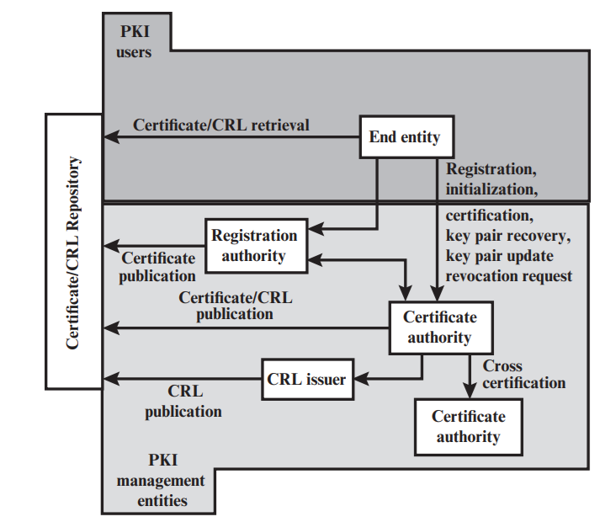
PKI Architectural Model

Slide 13
Key elements of the PKI model.
End entity: A generic term used to denote end users, devices (e.g., servers, routers), or any other entity that can be identified in the subject field of a public-key certificate.
Certification authority (CA): The issuer of certificates and (usually) certificate revocation lists (CRLs). It may also support a variety of administrative functions, although these are often delegated to one or more Registration Authorities.
Registration authority (RA): An optional component that can assume a number of administrative functions from the CA. The RA is often associated with the end entity registration process but can assist in a number of other areas as well

Slide 14
CRL issuer: An optional component that a CA can delegate to publish CRLs.
Repository: A generic term used to denote any method for storing certificates and CRLs so that they can be retrieved by end entities

Slide 15
PKI Management Functions
Registration: This is the process whereby a user first makes itself known to a CA (directly or through an RA), prior to that CA issuing a certificate or certificates for that user. Registration begins the process of enrolling in a PKI.
Initialization: Before a client system can operate securely, it is necessary to install key materials that have the appropriate relationship with keys stored elsewhere in the infrastructure
Certification: This is the process in which a CA issues a certificate for a user’s public key, returns that certificate to the user’s client system, and/or posts that certificate in a repository

Slide 16
Key pair recovery: Key pairs can be used to support digital signature creation and verification, encryption and decryption, or both.
Key pair update: All key pairs need to be updated regularly (i.e., replaced with a new key pair) and new certificates issued.
Revocation request: An authorized person advises a CA of an abnormal situation requiring certificate revocation.
Cross certification: Two CAs exchange information used in establishing a cross-certificate.

Slide 17
Email Security
email is one of the most widely used and regarded network services
currently message contents are not secure
may be inspected either in transit
or by suitably privileged users on destination system
Notes:
Current email services are roughly like "postcards". Anyone who wants could pick it up and have a look as its in transit or sitting in the recipients mailbox.

Slide 18
Email Security Enhancements
confidentiality
protection from disclosure
authentication
of sender of message
message integrity
protection from modification
non-repudiation of origin
protection from denial by sender
Notes:
What we want is something more akin to standard mail (contents protected inside an envelope) if not registered mail (have confidence about the sender of the mail and its contents).

Slide 19
Pretty Good Privacy (PGP)
widely used de facto secure email
developed by Phil Zimmermann
selected best available crypto algs to use
integrated into a single program
available on Unix, PC, Macintosh and Amiga systems
originally free, now have commercial versions available also

Slide 20
Notation
Ks = session key used in symmetric encryption scheme
PRa = private key of user A, used in public-key encryption scheme
PUa = public key of user A, used in public-key encryption scheme
EP = public-key encryption
DP= public-key decryption
EC = symmetric encryption
DC = symmetric decryption
H = hash function
|| = concatenation
Z = compression using ZIP algorithm

Slide 21
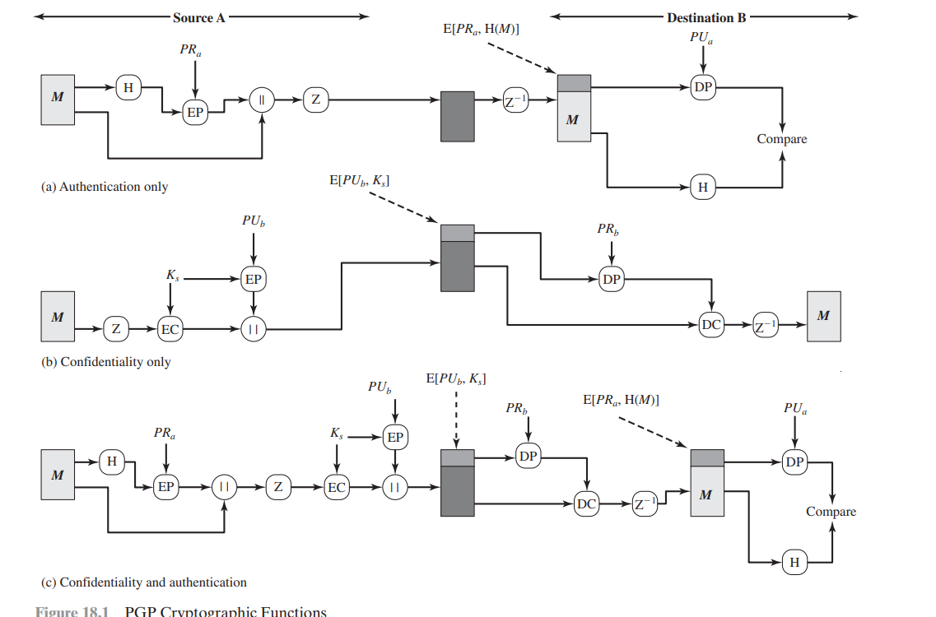
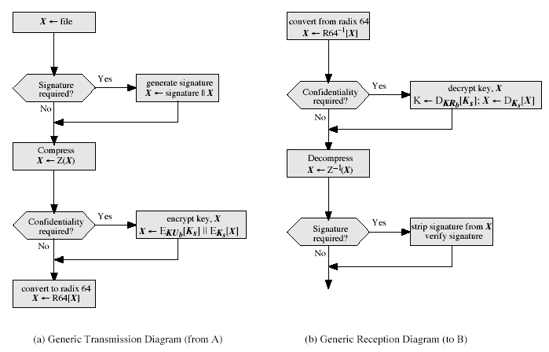
PGP Operation
Notes:
Stallings Fig 15-2.

Slide 22
PGP Operation – Authentication
sender creates a message
SHA-1 used to generate 160-bit hash code of message
hash code is encrypted with RSA using the sender's private key, and result is attached to message
receiver uses RSA or DSS with sender's public key to decrypt and recover hash code
receiver generates new hash code for message and compares with decrypted hash code, if match, message is accepted as authentic

Slide 23
PGP Operation – Confidentiality
sender generates message and random 128-bit number to be used as session key for this message only
message is encrypted, using CAST-128 / IDEA/3DES with session key
session key is encrypted using RSA with recipient's public key, then attached to message
receiver uses RSA with its private key to decrypt and recover session key
session key is used to decrypt message

Slide 24
PGP Operation – Confidentiality & Authentication
uses both services on same message
create signature & attach to message
encrypt both message & signature
attach RSA encrypted session key

Slide 25
PGP Operation – Compression
by default PGP compresses message after signing but before encrypting
so can store uncompressed message & signature for later verification
& because compression is non deterministic
uses ZIP compression algorithm

Slide 26
PGP Operation – Email Compatibility
when using PGP will have binary data to send (encrypted message etc)
however email was designed only for text
hence PGP must encode raw binary data into printable ASCII characters
uses radix-64 algorithm
maps 3 bytes to 4 printable chars
also appends a CRC
PGP also segments messages if too big

Slide 27
PGP Session Keys
need a session key for each message
of varying sizes: 56-bit DES, 128-bit CAST or IDEA (International Data for Encryption Algorithm), and
168-bit Triple-DES
generated using ANSI X12.17 mode
uses random inputs taken from previous uses and from keystroke timing of user

Slide 28
PGP Public & Private Keys
since many public/private keys may be in use, need to identify which is actually used to encrypt session key in a message
could send full public-key with every message
but this is inefficient
rather use a key identifier based on key
is least significant 64-bits of the key
will very likely be unique
also use key ID in signatures

Slide 29
S/MIME (Secure/Multipurpose Internet Mail Extensions)
Secure/Multipurpose Internet Mail Extension (S/MIME) is a security enhancement to the MIME Internet email format standard based on technology from RSA Data Security

Slide 30
S/MIME Operational Description
S/MIME provides for four message-related services:
authentication,
confidentiality,
compression,
email compatibility

Slide 31
Authentication
Authentication is provided by means of a digital signature.
Most commonly RSA with SHA-256 is used. The sequence is as follows:
1. The sender creates a message.
2. SHA-256 is used to generate a 256-bit message digest of the message.
3. The message digest is encrypted with RSA using the sender’s private key, and the result is appended to the message. Also appended is identifying information for the signer, which will enable the receiver to retrieve the signer’s public key.
4. The receiver uses RSA with the sender’s public key to decrypt and recover the message digest.
5. The receiver generates a new message digest for the message and compares it with the decrypted hash code. If the two match, the message is accepted as authentic.

Slide 32
S/MIME Services
Function | Typical Algorithm | Typical Action
Digital signature | RSA/SHA-256 | A hash code of a message is created using SHA-256. This message digest is encrypted using SHA-256 with the sender’s private key and included with the message.
Message encryption | AES-128 with CBC | A message is encrypted using AES-128 with CBC with a one-time session key generated by the sender. The session key is encrypted using RSA with the recipient’s public key and included with the message.
Compression | unspecified | A message may be compressed for storage or transmission.
Email compatibility | Radix-64 conversion | To provide transparency for email applications, an encrypted message may be converted to an ASCII string using radix-64 conversion.

Slide 33
Confidentiality
S/MIME provides confidentiality by encrypting messages.
1. The sender generates a message and a random 128-bit number to be used as a content-encryption key for this message only.
2. The message is encrypted using the content-encryption key.
3. The content-encryption key is encrypted with RSA using the recipient’s public key and is attached to the message.
4. The receiver uses RSA with its private key to decrypt and recover the content-encryption key.
5. The content-encryption key is used to decrypt the message.

Slide 34
Email Compatibility
When S/MIME is used, at least part of the block to be transmitted is encrypted.
If only the signature service is used, then the message digest is encrypted (with the sender’s private key).
If the confidentiality service is used, the message plus signature (if present) are encrypted (with a one-time symmetric key).

Slide 35
Compression
S/MIME also offers the ability to compress a message.
This has the benefit of saving space both for email transmission and for file storage

Slide 36
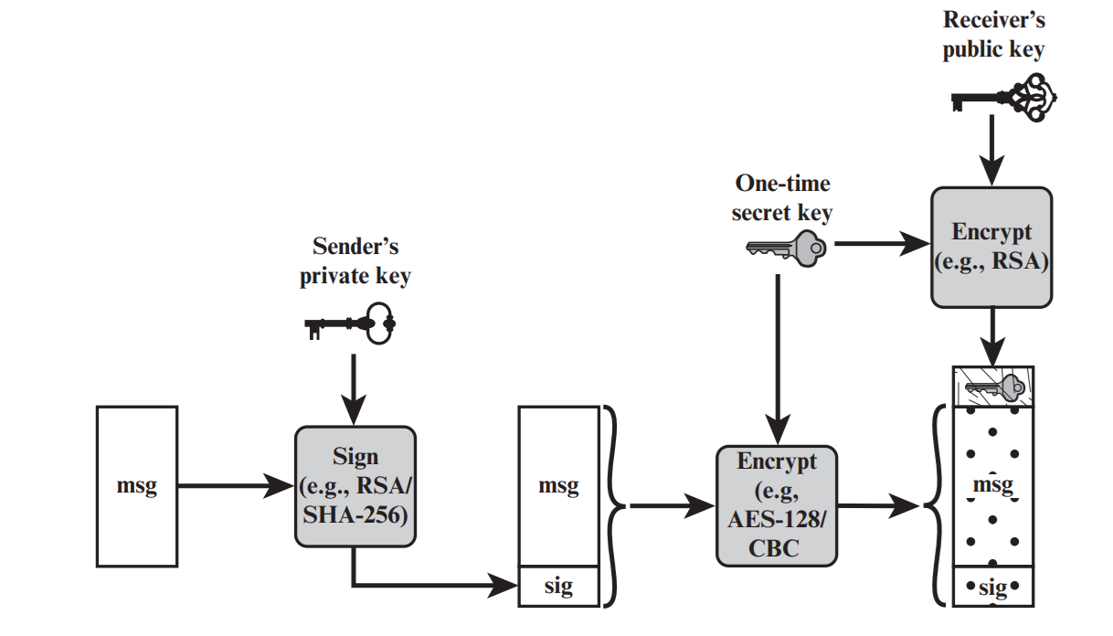
Simplified S/MIME Functional Flow
(a) Sender signs, then encrypts message

Slide 37
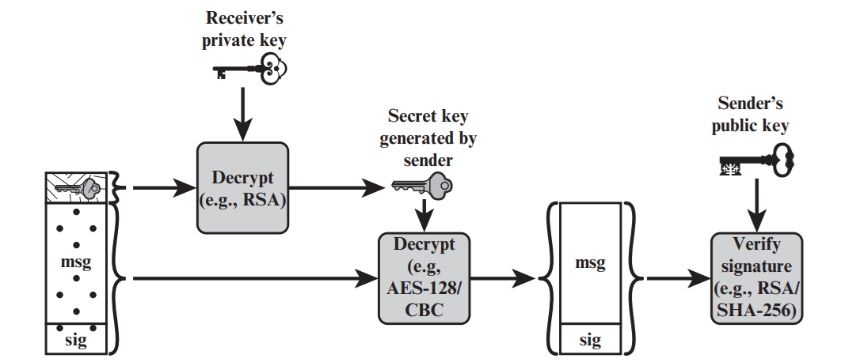
(b) Receiver decrypts message, then verifies sender’s signature

Slide 38
S/MIME Message Content Types
S/MIME uses the following message content types, which are defined in RFC 5652.
Data: Refers to the inner MIME-encoded message content, which may then be encapsulated in a SignedData, EnvelopedData, or CompressedData content type.
SignedData: Used to apply a digital signature to a message.
EnvelopedData: This consists of encrypted content of any type and encrypted-content encryption keys for one or more recipients.
CompressedData: Used to apply data compression to a message.

Slide 39
IP Security
IP-level security incorporates three functional areas: authentication, confidentiality, and key management.
The authentication mechanism assures that a received packet was, in fact, transmitted by the party identified as the source in the packet header.
In addition, this mechanism assures that the packet has not been altered in transit.
The confidentiality facility enables communicating nodes to encrypt messages to prevent eavesdropping by third parties.
The key management facility is concerned with the secure exchange of keys.

Slide 40
IP Security Policy
Fundamental to the operation of IPsec is the concept of a security policy applied to each IP packet that transits from a source to a destination.
IPsec policy is determined primarily by the interaction of two databases, the security association database (SAD) and the security policy database (SPD)

Slide 41
Security Association (SA)
A key concept that appears in both the authentication and confidentiality mechanisms for IP is the security association (SA).
An association is a one-way logical connection between a sender and a receiver that affords security services to the traffic carried on it.
If a peer relationship is needed for two-way secure exchange, then two security associations are required

Slide 42
Security Association Database
In each IPsec implementation, there is a nominal Security Association Database that defines the parameters associated with each SA.

Slide 43
Security Policy Database
IP traffic is related to specific SAs (or no SA in the case of traffic allowed to bypass IPsec) is the nominal Security Policy Database (SPD).
In its simplest form, an SPD contains entries, each of which defines a subset of IP traffic and points to an SA for that traffic.
In more complex environments, there may be multiple entries that potentially relate to a single SA or multiple SAs associated with a single SPD entry.

Slide 44
IP Traffic Processing
IPsec is executed on a packet-by-packet basis.
When IPsec is implemented, each outbound IP packet is processed by the IPsec logic before transmission, and each inbound packet is processed by the IPsec logic after reception and before passing the packet contents on to the next higher layer (e.g., TCP or UDP).

Slide 45
Encapsulating Security Payload (ESP)
ESP can be used to provide confidentiality, data origin authentication, connectionless integrity, an anti-replay service (a form of partial sequence integrity), and (limited) traffic flow confidentiality.
The set of services provided depends on options selected at the time of Security Association (SA) establishment and on the location of the implementation in a network topology.
ESP can work with a variety of encryption and authentication algorithms, including authenticated encryption algorithms such as GCM

Slide 46
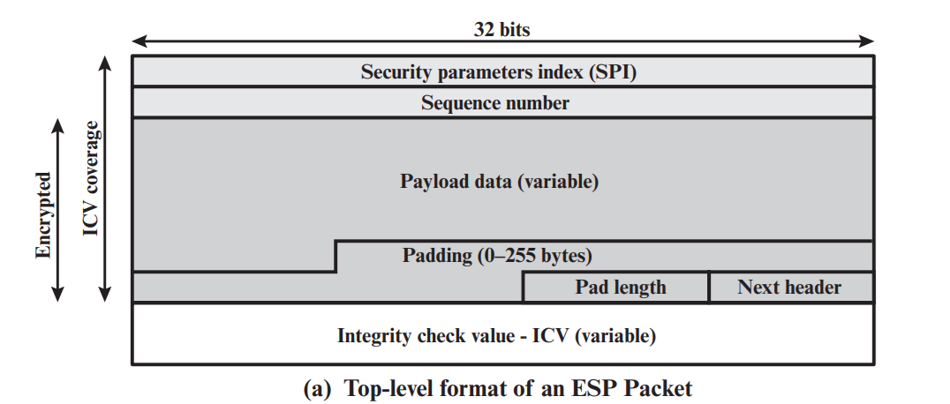
Encapsulating Security Payload
Notes:
Stallings Fig 16-7.

Slide 47
Security Parameters Index (32 bits): Identifies a security association.
Sequence Number (32 bits): A monotonically increasing counter value; this provides an anti-replay function, as discussed for AH.
Payload Data (variable): This is a transport-level segment (transport mode) or IP packet (tunnel mode) that is protected by encryption.

Slide 48
Padding (0–255 bytes): Padding field is used to expand the plaintext (consisting of the Payload Data, Padding, Pad Length, and Next Header fields) to the required length.
Pad Length (8 bits): Indicates the number of pad bytes immediately preceding this field.
Next Header (8 bits): Identifies the type of data contained in the payload data field by identifying the first header in that payload (e.g., an extension header in IPv6, or an upper-layer protocol such as TCP).
Integrity Check Value (variable): A variable-length field (must be an integral number of 32-bit words) that contains the Integrity Check Value computed over the ESP packet minus the Authentication Data field.

Slide 49
Web Security
Web now widely used by business, government, individuals
but Internet & Web are vulnerable
have a variety of threats
integrity
confidentiality
denial of service
authentication
need added security mechanisms

Slide 50
SSL (Secure Socket Layer)
Secure Socket Layer (SSL) provides security services between TCP and applications that use TCP.
The Internet standard version is called Transport Layer Service (TLS).
SSL/TLS provides confidentiality using symmetric encryption and message integrity using a message authentication code.
SSL/TLS includes protocol mechanisms to enable two TCP users to determine the security mechanisms and services they will use
Notes:
SSL probably most widely used Web security mechanism. Its implemented at the Transport layer; cf IPSec at Network layer; or various Application layer mechanisms eg. S/MIME & SET (later).

Slide 51
SSL Architecture
SSL is designed to make use of TCP to provide a reliable end-to-end secure service.
SSL is not a single protocol but rather two layers of protocols
The SSL Record Protocol provides basic security services to various higher layer protocols.
In particular, the Hypertext Transfer Protocol (HTTP), which provides the transfer service for Web client/server interaction, can operate on top of SSL.

Slide 52
Three higher-layer protocols are defined as part of SSL: the Handshake Protocol, The Change Cipher Spec Protocol, and the Alert Protocol.
These SSL-specific protocols are used in the management of SSL exchanges.

Slide 53
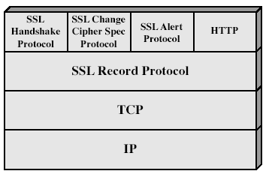
SSL Architecture
Notes:
Stallings Fig 17-2.

Slide 54
Two important SSL concepts are the SSL session and the SSL connection, which are defined in the specification as follows.
SSL session
An SSL session is an association between a client and a server.
Sessions are created by the Handshake Protocol.
Sessions define a set of cryptographic security parameters which can be shared among multiple connections

Slide 55
SSL connection
A connection is a transport (in the OSI layering model definition) that provides a suitable type of service.
For SSL, such connections are peer-to-peer relationships.
The connections are transient.
Every connection is associated with one session

Slide 56
SSL Record Protocol
The SSL Record Protocol provides two services for SSL connections:
Confidentiality: The Handshake Protocol defines a shared secret key that is used for conventional encryption of SSL payloads.
Message Integrity: The Handshake Protocol also defines a shared secret key that is used to form a message authentication code (MAC).
Notes:
SSL Record Protocol defines these two services for SSL connections.

Slide 57
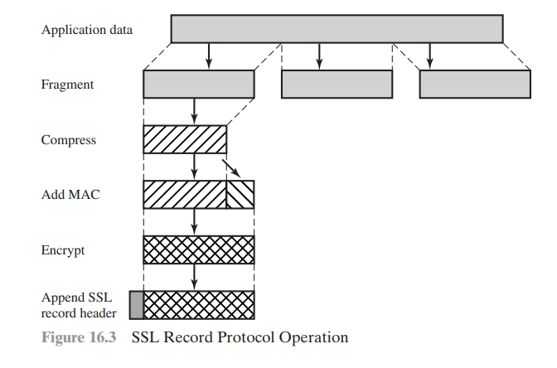
SSL Record Protocol Operation

Slide 58
The overall operation of the SSL Record Protocol.
The Record Protocol takes an application message to be transmitted, fragments the data into manageable blocks, optionally compresses the data, applies a MAC, encrypts, adds a header, and transmits the resulting unit in a TCP segment.
Received data are decrypted, verified, decompressed, and reassembled before being delivered to higher-level users

Slide 59
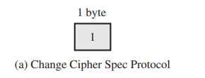
SSL Change Cipher Spec Protocol
The Change Cipher Spec Protocol is one of the three SSL-specific protocols that use the SSL Record Protocol, and it is the simplest.
This protocol consists of a single message which consists of a single byte with the value 1.
The sole purpose of this message is to cause the pending state to be copied into the current state, which updates the cipher suite to be used on this connection

Slide 60
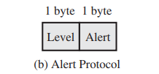
SSL Alert Protocol
The Alert Protocol is used to convey SSL-related alerts to the peer entity.
As with other applications that use SSL, alert messages are compressed and encrypted, as specified by the current state.
Each message in this protocol consists of two bytes.
The first byte takes the value warning (1) or fatal (2) to convey the severity of the message.
If the level is fatal, SSL immediately terminates the connection.

Slide 61
SSL Handshake Protocol
allows server & client to:
authenticate each other
to negotiate encryption & MAC algorithms
to negotiate cryptographic keys to be used
comprises a series of messages in phases
Establish Security Capabilities
Server Authentication and Key Exchange
Client Authentication and Key Exchange
Finish

Slide 62
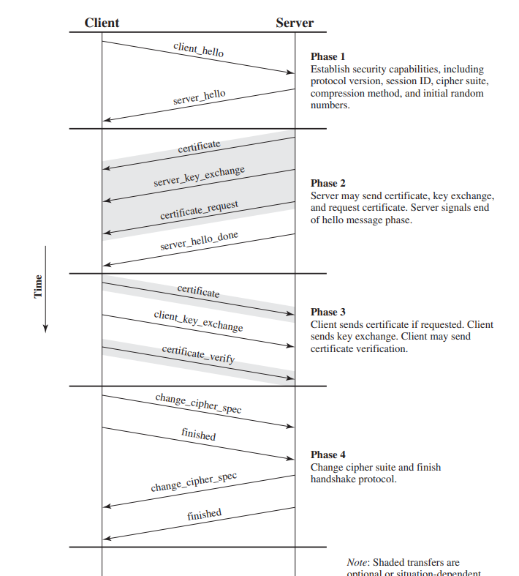
SSL Handshake Protocol
Notes:
Stallings Fig 17-6.

Slide 63
Transport Layer Security
One of the most widely used security services is Transport Layer Security (TSL); the current version is Version 1.2, defined in RFC 5246.
TLS is an Internet standard that evolved from a commercial protocol known as Secure Sockets Layer (SSL).

Slide 64
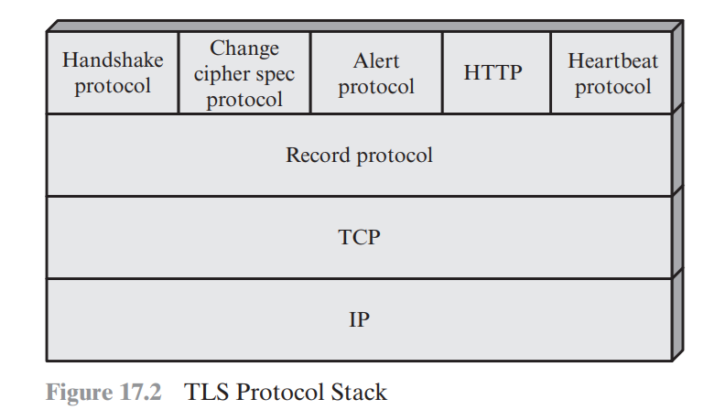
TLS Architecture
TLS is designed to make use of TCP to provide a reliable end-to-end secure service.

Slide 65
The TLS Record Protocol provides basic security services to various higher layer protocols.
In particular, the Hypertext Transfer Protocol (HTTP), which provides the transfer service for Web client/server interaction, can operate on top of TLS.
Three higher-layer protocols are defined as part of TLS: the Handshake Protocol; the Change Cipher Spec Protocol; and the Alert Protocol.
These TLS specific protocols are used in the management of TLS exchanges.
A fourth protocol, the Heartbeat Protocol, is defined in a separate RFC

Slide 66
TLS Record Protocol
The TLS Record Protocol provides two services for TLS connections:
Confidentiality: The Handshake Protocol defines a shared secret key that is used for conventional encryption of TLS payloads.
Message Integrity: The Handshake Protocol also defines a shared secret key that is used to form a message authentication code (MAC).

Slide 67
Change Cipher Spec Protocol
The Change Cipher Spec Protocol is one of the four TLS-specific protocols that use the TLS Record Protocol, and it is the simplest.
This protocol consists of a single message which consists of a single byte with the value 1.
The sole purpose of this message is to cause the pending state to be copied into the current state, which updates the cipher suite to be used on this connection.

Slide 68
Alert Protocol
The Alert Protocol is used to convey TLS-related alerts to the peer entity.
Handshake Protocol
The most complex part of TLS is the Handshake Protocol.
This protocol allows the server and client to authenticate each other and to negotiate an encryption and MAC algorithm and cryptographic keys to be used to protect data sent in a TLS record

Slide 69


